Slide 1
Indian Agriculture Analysis
Name: Shashanka N Shetty
Batch: MIP-DA-04

Slide 2
Introduction
India’s agriculture sector stands as a cornerstone of its economy, contributing significantly to the Gross Domestic Product (GDP) and providing sustenance to a substantial portion of its population. This sector, rich in diversity due to the country’s vast array of climatic conditions and terrain, produces a wide variety of crops, ranging from staples like rice and wheat to cash crops such as cotton . The success and sustainability of agricultural practices are crucial not only for India’s food security but also for the livelihood of millions of farmers across the nation.

Slide 3
The purpose of this analysis is multifold:
Analyze the India Crop trends production and area from 1966 to 2017.
Summarize the Crop Production, Crop Area, Crop Efficiency based on the years, states and category.

Slide 4
Some interesting insights that i like to share through this project:
From 1966 to 2017, the North Zone especially Uttar Pradesh state always contribute almost 40% to India Crop production, whereas Northeast Zone, Assam state have only 1% of contribution to India production.
Cereals is always the main category of crop production with more than 70% to India, which support to the increase of India’s population.
North East zone, where is Assam state is always the least contribution to India Crop Production.

Slide 5
The Data
The dataset consist of 16146 rows and 80 columns about the production, area and yield of each crop products.
The shape of the dataset is 16146 rows and 80 columns. I see the data was collected by group of years on every states and districts of India, it doesn’t have any months or quarters. Additionally, the crop products has its own columns production, area and yield, which make the data look messy, and it is hard to understand.

Slide 6
Insights

Slide 7
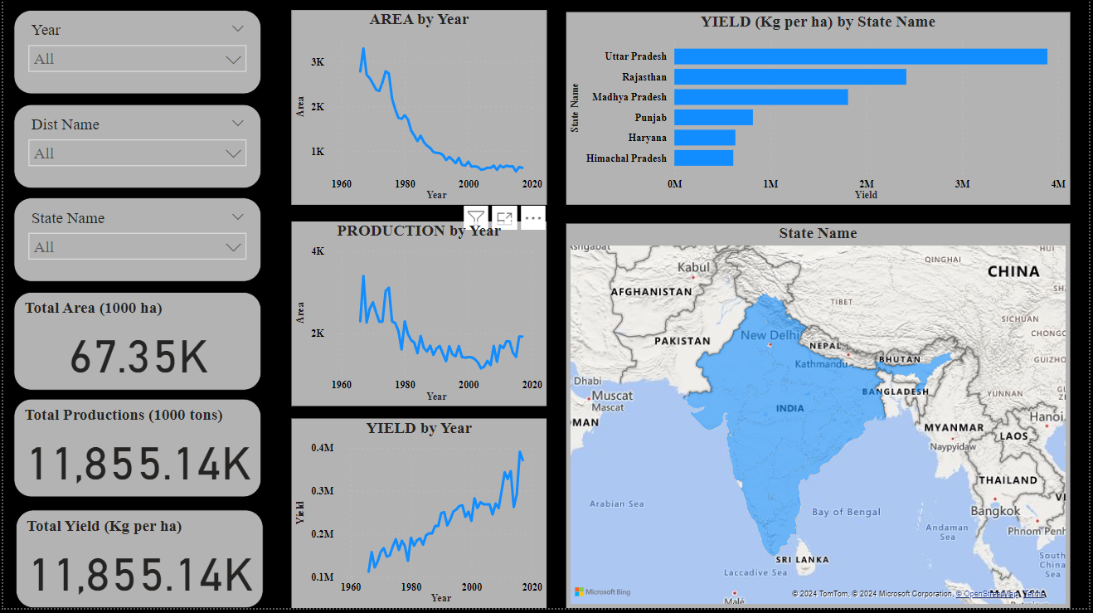

Slide 8
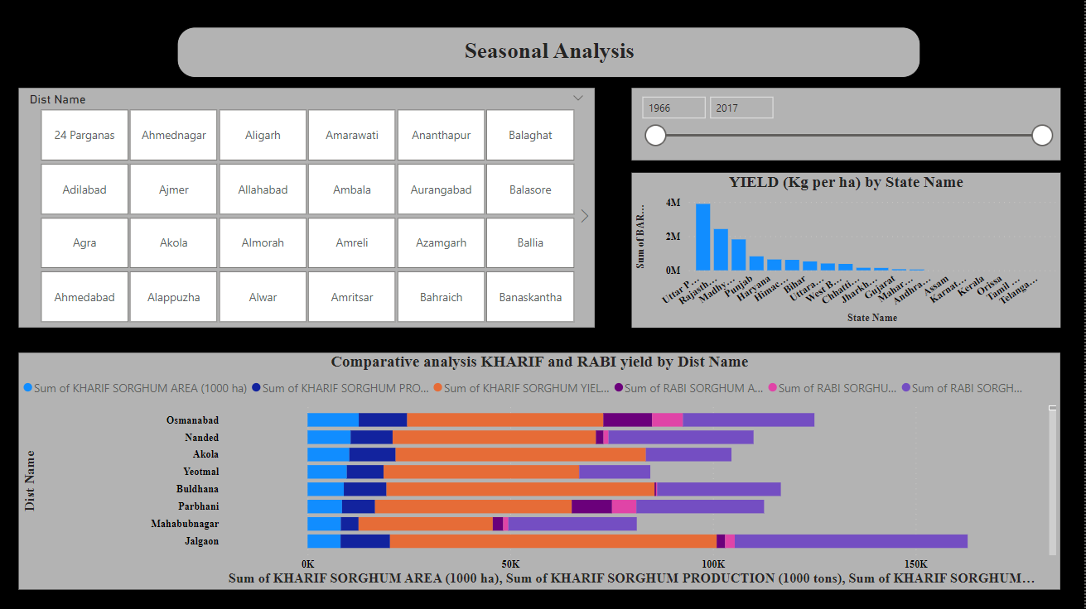

Slide 9
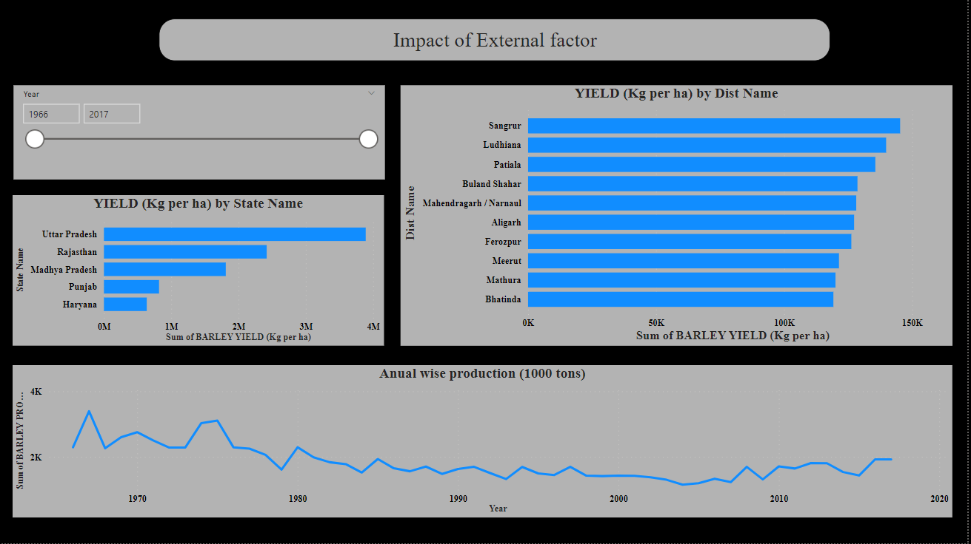

Slide 10
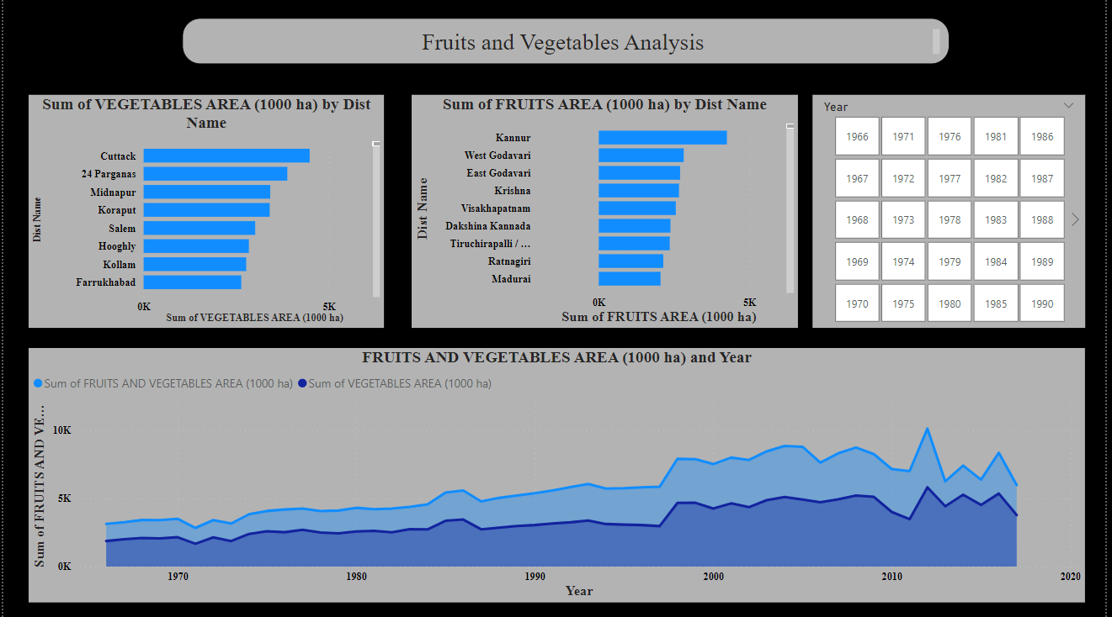

Slide 11
Thank You

